Slide 1
Business Performance ABC
Noverdy Safrizal

Slide 2
Table of Content
01. Background & Objective
02. Scope & Measurements
03. Business Performance Analysis
04. Problem & Recomendation
05. Closing

Slide 3

Background
Current business knowledge
Describe business performance based on data sales to track how to sales be slowly
Kind of possible problem
ABC maybe have some problem related growth of sales,
Need to improve business process
ABC has to know where the main business wakness point with data to improve customer satisfication

Slide 4
Objective
Overall Business Performance
Sales & Product Performance
Duration Ordered Performance

Slide 5
Scope Measurement
Data Source
Using Data Company ABC
Data Range
Using Data Januari 2018 – Desember 2021

Slide 6
Measurement
Terms | Description
Sales Amount | Value of sales amount
Sales Qty | Value of sales quantity product
Profit Amount | Profit or margin
Total Transaction | Total transactions based on ordered transactions
UB | Total Unique Buyer based on customer ordered
Total Product | Total Unique Product ordered

Slide 7
Yearly Trend
+43%
+65%
+66%
2018
2019
2020
2021
2018
2019
2020
2021
2018
2019
2020
2021
Sales (in $)
Sales Qty
Profit (in $)

Slide 8
Yearly Trend
+16%
+74%
+24%
2018
2019
2020
2021
2018
2019
2020
2021
2018
2019
2020
2021
(otal Customer
Total Transactions
Total Product

Slide 9
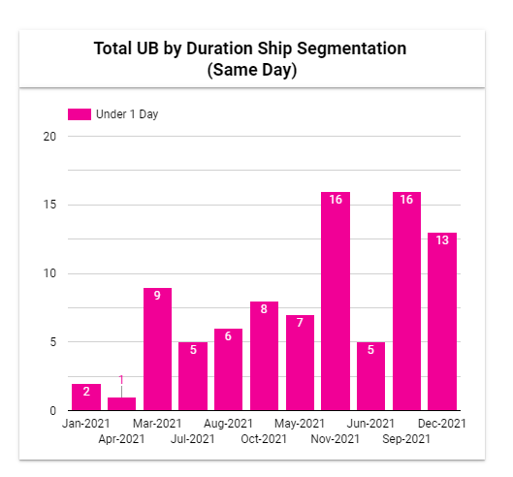
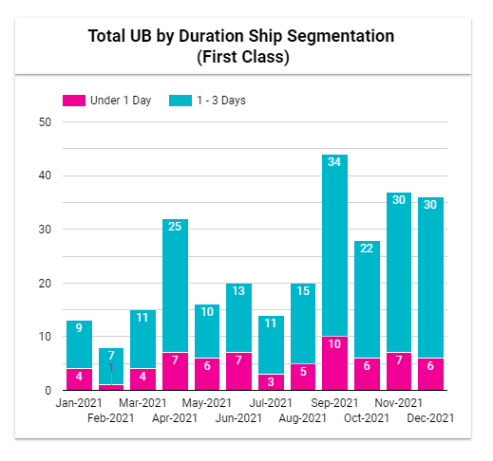
UB by Range Order Date to Ship Date

Slide 10
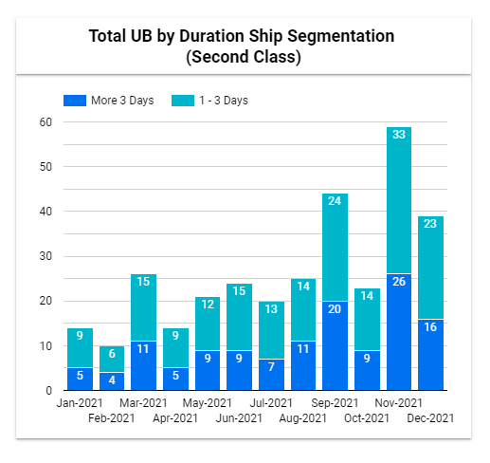
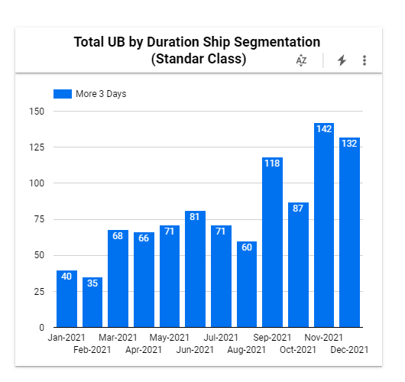
UB by Range Order Date to Ship Date

Slide 11
Result of Yearly Trend
Sales Amount
Unique Buyer
Based on data, sales amount every year growth. And increase from 2021 compared 2018 be 43%.
Based on data, unique every year growth. And increase from 2021 compared 2018 be 16%. On selected year in 2021, UB by range ordered to ship date must be improve spesific on ship mode first class and second class to increas satisfication customer
Sales Qty
Based on data, sales quantity every year growth. And increase from 2021 compared 2018 be 65%
Total Transactions
Based on data, sales amount every year growth. And increase from 2021 compared 2018 be 74%
Profit Amount
Based on data, sales amount every year growth. And increase from 2021 compared 2018 be 66%
Product Sold
Based on data, sales amount every year growth. And increase from 2021 compared 2018 be 24%

Slide 12
Montly Trend Sales Profit Based on data 2021
-48%
-31%
Jan-21
Feb-21
Mar-21
Apr-21
Mei-21
Jun-21
Jul-21
Agu-21
Sep-21
Okt-21
Nov-21
Des-21
Jan-21
Feb-21
Mar-21
Apr-21
Mei-21
Jun-21
Jul-21
Agu-21
Sep-21
Okt-21
Nov-21
Des-21
Sales (in $)
Profit (in $)
Important to note in Oct 2021, It decreased by 32% in sales quantity and 48 % in profit from Sept 2021

Slide 13
Montly Trend Sales Profit Based on data 2021
-32%
-35%
Jan-21
Feb-21
Mar-21
Apr-21
Mei-21
Jun-21
Jul-21
Agu-21
Sep-21
Okt-21
Nov-21
Des-21
Jan-21
Feb-21
Mar-21
Apr-21
Mei-21
Jun-21
Jul-21
Agu-21
Sep-21
Okt-21
Nov-21
Des-21
Sales Qty
Total Product Ordered
Important to note in oct 2021, It decreased by 32% in sales quantity and 35 % in product ordered from sept 2021.

Slide 14
Montly Trend Sales Profit Based on data 2021
-31%
-35%
Jan-21
Feb-21
Mar-21
Apr-21
Mei-21
Jun-21
Jul-21
Agu-21
Sep-21
Okt-21
Nov-21
Des-21
Jan-21
Feb-21
Mar-21
Apr-21
Mei-21
Jun-21
Jul-21
Agu-21
Sep-21
Okt-21
Nov-21
Des-21
UB
Transactions
Important to note in oct 2021, It decreased by 31% in UB and 35 % in transaction from sept 2021.

Slide 15
Detail Growth by Product Category
Important to note, specific product category “furniture” have to take an action. Because that product category growth
-263%. And overall in oct 2021 month decreased minus compared sept 2021 based on several KPI.

Slide 16
UB Classification Spesific October 2021
UB by Ship Mode
UB by Ship Status
UB by Segment
Same Day
Shipped On Time
Corporate
Shipped Early
First Class
Consumer
Second Class
Shipped Late
Home Office
Standard Class
In october 2021, The biggest buyer segment from Consumer is 43%. Based on ship mode majority buyer used standar class is 60%. And buyer have status delivery is shipped late is 28%.

Slide 17
Problem
Delivery time take a long duration
Product Category “Furniture” need to be take actions because non profitable on oct 2021
Decrese on several measurement
Campaign promotion related discount must suitable spesific segment of buyer

Slide 18
Recomendation
More be aware related delivery ship mode, and establish coorporation with delivery service. So, can increase satisfication customer with easy reporting if any issue and handle late delivery time
Reduce promotion related biggest category non profitable like this category and searching new seller to increase variations of product from cheap price until expensive price
Use Monitoring system like report using for track daily traffic buyer and situation of sale. And with live reporting tools every department category product or marketing able to take an action if any drop sales
Digital marketing Department able to use campaign suitable for every month. This used to keep customer happy shopping and keep good traffic in this commerce
Doing customer satisfaction survey in every purchase product, and based on data able to know how to increase for good system and service from customer

Slide 19

Thank you
Noverdy safrizal

